Slide 1

Lingayas Institute of Management and Technology
(Autonomous)
Approved by AICTE, Affiliated to JNTU Kakinada, Accredited with A Grade by NAAC and
UG-CSE is accredited by NBA
Summer Internship presentation on
Resume builder by using Django
Roll Number: Ogirala Sudha
Name:21NA1A0513
Mentor:
Professor
M.Jagadish sir
Department of Computer science and Engineering

Slide 2
Contents
*Executive Summary
*Overview of the Orginization
*Internship part
*Activity log for the first week
*Outcomes descripition
Summary

Slide 3
What is Python?
*Python is an interpreted,object-oriented,high level programming languages with dynamic symantics.
*Python is used for server-side web devolopment,software devolopment,and it is popular for Rapid Application Devolopment.
*Python is that it operates on any platforms whether Macintosh,Windows,Linux,Solaries,and more.

Slide 4
Objectives
*Data Science carreer oppurtunities.
*Machine Learning deep roots.
*Accelerating and Simiplyfing Web Devolopment.
*Designing and Devoloping databases and user interfaces.
*Students will design and devolop front-end user interfaces using
HTML,CSS,and JavaScript.

Slide 5
Outcomes
*Understanding and Use Variables.
*Ability to design,devolop,and maintain end-to-end web applications.
*Strong problem-solving and debbugging skills.
*Obtains basic Summary statistics from data files.

Slide 6

Overveiw of the Orginization
*Pantech E learning is a privated limited company and it is located in Chennai ,Tamilnadu.
*Pantech E learning privated limited company has three directors-Senthikumar Ramasamy,Muniappa Gounder,Sivaraman Meena and others.
*The Corporate Identification Number(CIN) of
Pantech E learning is U80902TN2021PTC141464.

Slide 7
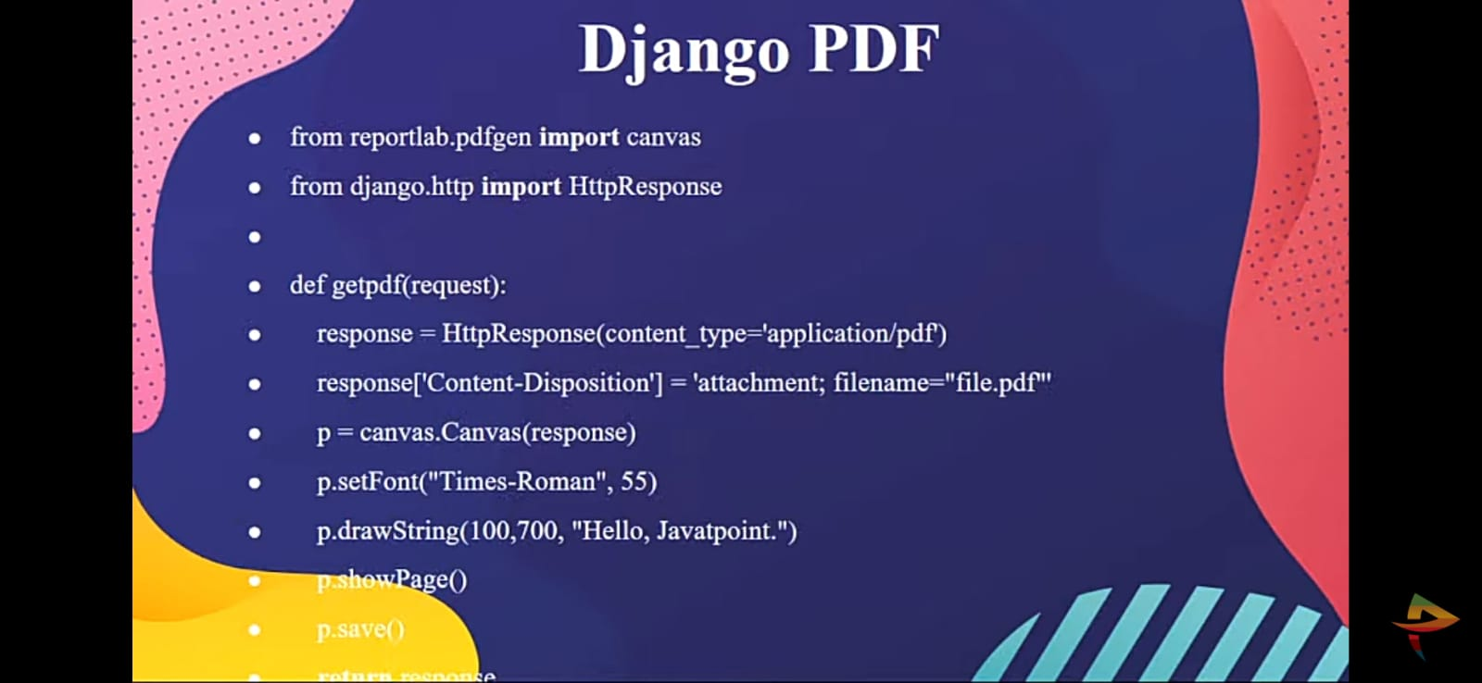
Django PDF:
*To generate PDF,we will use ReportLab Python PDF library that creates customised dynamic PDF.
*//views.py

Slide 8
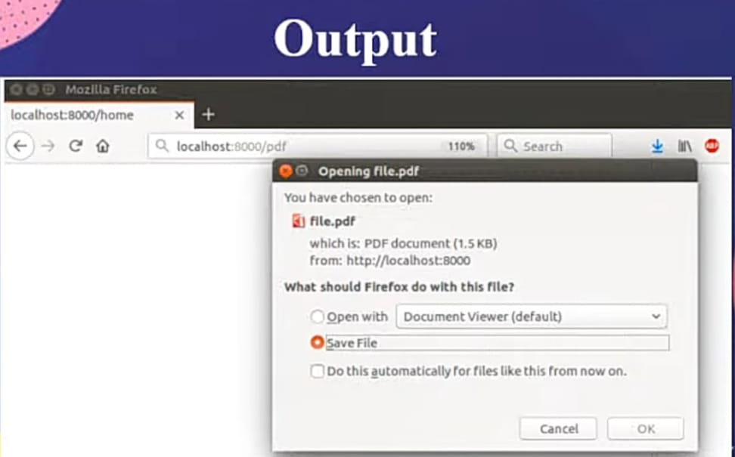
Output:

Slide 9
Internship Part
During my internship at PANTECH ,I was involved in the online classes that helped me learn and practice the skills and knowledge of my skill devolopment.
Weekly schedule:
They have sended me some recorded classes.My guide was Nandhini madam.I had started my internship from june 6th 2023 to july 6th 2023.each class for 45 minutes,per day from monday to friday,from 5pm to 6pm.

Slide 10
Technical skills:
I acquried techinical skills such as programming languages(Python).
Day | DAILY ACTIVITY | OUTCOMES
Day 1 | Python programming | Fundementals
Day 2 | Tool Boxes Python | Basic information about Python.
Day 3 | Fundemental libraries for python programming | About rhe fundementals for the devolopment.
Day 4 | Integrated devolopment environment | How python is used for the devolpoment.
Day 5 | HTML,CSS,JavaScript | To create beautiful and user-friendly websites.

Slide 11
Outcomes Description:
*Working in a virtual environment has been an exiciting and rewarding experience fo me.
*I have exchanged ideas ,opinions and feedback with them through various platforms and tools.

Slide 12
Thank You

